Slide 1


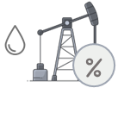
PTIT Public Lecture:
THAILAND IV – is it time to revise the Thai Petroleum Act
to revitalize energy security and support realistic energy transition?
A Case for new Thai Petroleum Fiscal Regime for Oil and Gas E&P to manage the country’s energy security risks and provide for an effective energy transition
Wednesday, 7 August 2024 at 14:00-15:00 hrs.
PTT Auditorium, 2nd Floor, PTT Building 1, Vibhavadi Rangsit Road
by
Dr. Pedro van Meurs
VAN MEURS ENERGY (VME)
Panama City, Panama
e-mail: info@vanmeursenergy.com
website: vanmeursenergy.com

Slide 2
INTRODUCTION
KEY TOPICS
NetZero by 2070
The Thailand IV fiscal regime
A broader approach to CCS
Improved tax regime for decommissioning
Incentives for petrochemical feedstock
Amendments to Concessions and PSCs
2

Slide 3
NET ZERO BY 2070
World Forecast
The VME forecast is that NetZero will not be achieved by 2050 on a worldwide basis
for the following reasons:
China, Brazil, Nigeria, Russia and some other nations only intent to reach NetZero
by 2060, while India anticipates reaching it by 2070. Also, there important countries that have not set a target at all, such as Iran, Iraq, Egypt, Angola and the Philippines.
Most developing countries simply do not have the funds to finance such a strong transition, and developed countries are unwilling to provide most of this financing for them.
There will be strong “not in my backyard” opposition to the major expansion
of the electricity grid and other required energy projects, delaying most of
the projects.
3

Slide 4
NET ZERO BY 2070
World Forecast
Worldwide NetZero might be achieved by 2070 because as evidence of the negative effects of climate change grows stronger based on ever higher temperatures and more rapid melting of glaciers in Greenland and Antarctica, governments will increasingly implement stronger energy transition measures.
4

Slide 5
NET ZERO BY 2070
World Forecast
However, the main reasons are the expectations for rapid solar development. The year 2023 was a banner year for solar energy.
According to the International Energy Agency (“IEA”) World Energy Investment Report in 2023 investments in solar power were higher than in all other sources combined (coal+oil+gas+wind+hydro+nuclear).
5

Slide 6
NET ZERO BY 2070
World Forecast
Solar plus storage will rapidly become cheaper:
-- Solar panel efficiencies may reach 27% by 2030, more than 25% higher than current levels.
-- New developments in silicon panels and emerging PV cells, such as perovskite and organic cells will make solar panels cheaper.
-- Furthermore, the IEA forecast is that by 2030 batteries will be 40% cheaper.
6

Slide 7
NET ZERO BY 2070
World Forecast
Based on IEA forecast, in areas with favorable solar conditions the world average solar plus co-located storage costs could drop below 4.5 cents/kWh (1.60 Baht/kWh) by 2030. This is well below the current TOD rate for large users in Thailand.
VME high and low show the range of costs of solar plus co-located storage projects in 2023 and 2024 and the related forecast.
Huge activity in solar plus co-located storage is taking place in the United States and India, but the VME database also includes projects in Thailand and 69 other countries as diverse as Finland, Burkina Faso and Tonga.
7

Slide 8
NET ZERO BY 2070
World Forecast
VME developed a 2070 Net Zero scenario based on the IEA APS scenario. This forecast shows that there still will be a significant petroleum industry in 2070 producing 45 million barrels of oil per day of oil and 56 trillion cubic feet per year of natural gas. There will be essentially no growth of total energy production due to much higher efficiencies in energy use.
8

Slide 9
NET ZERO BY 2070
World Forecast
VME 2070 NetZero forecast contemplates by 2070 a significant oil industry producing 45 million bopd, consisting of green synthetic fuels, biofuels, NGLs and Naphtha largely used for petrochemical purposes, asphalt and abated crude oil.
9

Slide 10
NET ZERO BY 2070
World Forecast
VME 2070 NetZero forecast contemplates by 2070 a significant gas industry
of 56 Tcf/year, producing natural gas subject to CCS and other abated gas.
10

Slide 11
NET ZERO BY 2070
Thailand
What are the perspectives for Thailand?
The goal of Thailand is to be carbon neutral by 2050.
Can this be achieved?
11

Slide 12
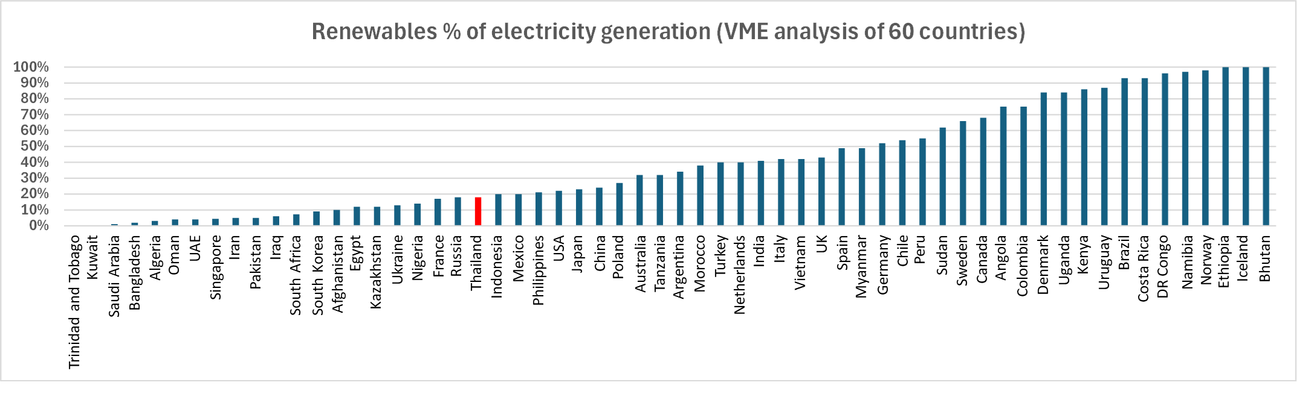
NET ZERO BY 2070
Thailand
Thailand generates only 18% of its power from renewable resources. This compares unfavorably
to many other countries.
The VME analysis includes all countries with more than 40 million people.
12

Slide 13
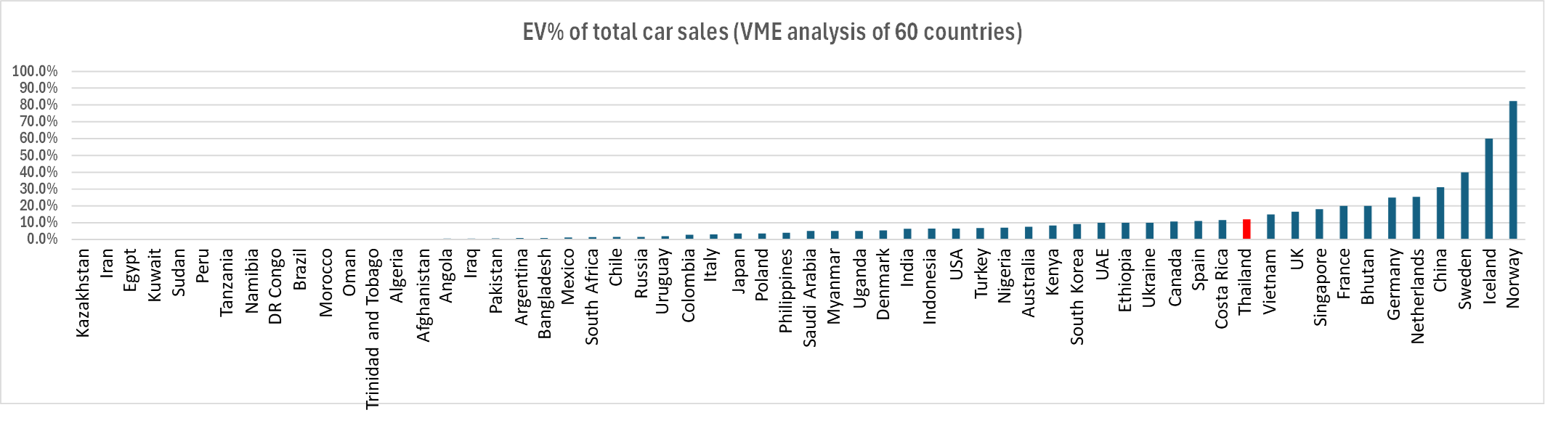
NET ZERO BY 2070
Thailand
Thailand EV sales are 12% of the car market. This compares favorably to many other countries.
13

Slide 14
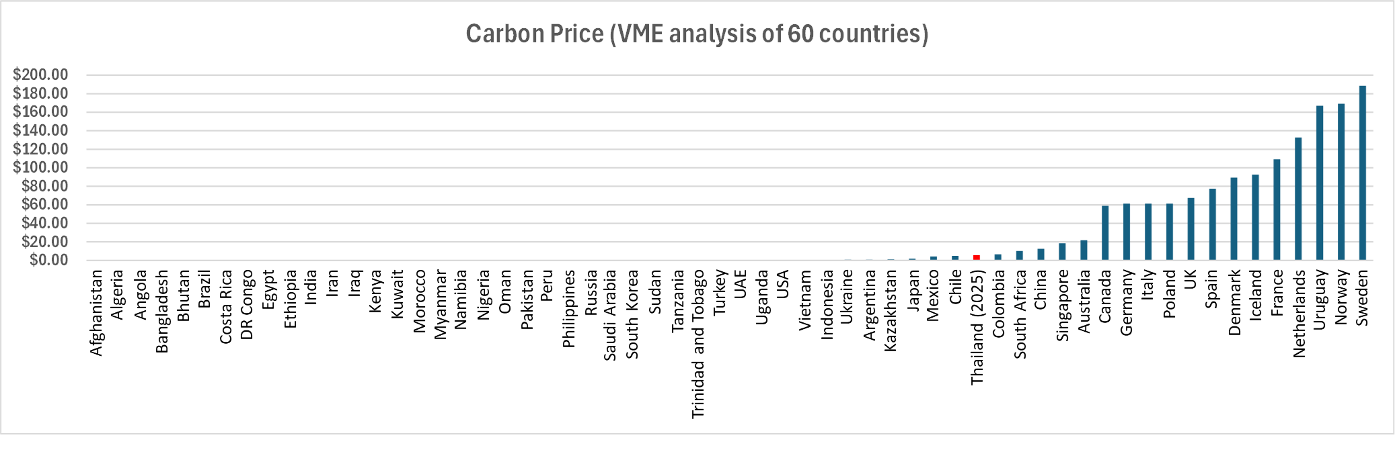
NET ZERO BY 2070
Thailand
Once Thailand has established the carbon tax of 200 Baht/ton, it will be part of
a group of nations with a very low carbon tax. However, it should be noted that most nations do not have a carbon tax or have carbon trading.
14

Slide 15
NET ZERO BY 2070
Thailand
-- In addition to promoting EVs, Thailand is taking some other positive steps towards being carbon neutral by 2050.
-- The ERC procurement scheme for 2022 and 2023 so far is for a multitude of small scale projects of a total of about 12 GW. Under this scheme Thailand has created 24 solar plus storage projects of a total of 994 MW,
the largest being 49 MW solar plus 136 MWh storage project by Sungrow at 2.83 Baht/kWh in Sa Kaeo province. This will have a positive impact.
-- EGAT in addition to the Sirindhorn reservoir is planning to install more than 2GW of floating solar on hydro reservoirs.
-- However, this is insufficient to reach the 2050 goal.
15

Slide 16
NET ZERO BY 2070
Thailand
-- There is no “pipeline” of investment proposals for large solar and wind projects, as in many other countries.
-- EGAT is instead planning to construct 20 GW of combined cycle gas prior
to 2037 in order to reach a total installed capacity of 77 GW.
-- Large utility solar projects are missing. This is surprising because due to further technical progress utility solar plus storage might be provided for less than 2 Baht/kWh at the exit of the solar plant in 2030. Many countries have large solar projects, including Myanmar and Vietnam.
16

Slide 17
NET ZERO BY 2070
Thailand
-- EGAT estimates the offshore wind potential at 13 GW. However,
at this time there are no large scale Thai offshore wind project under development. International examples are:
Brazil – 6507 MW Ventas do Sul
South Korea – 3200 MW Jindo offshore wind cluster
Vietnam – 3500 MW La Gan
Philippines – 1200 MW Bulalacao
Shanghai City - 29,000 MW of offshore wind.
17

Slide 18
NET ZERO BY 2070
Thailand
-- Thailand has a huge agrivoltaic potential which based on a VME estimate is at least 100 GW, enough to provide all of Thailand’s electricity. Yet I am not aware of any agrivoltaic projects being done.
-- The successful introduction of renewables is the depends on large scale storage. Yet Thailand has not a single large battery electric storage project.
-- Green hydrogen is critical for achieving NetZero. Currently the world is investing US $ billions in green hydrogen. Yet, Thailand does not have a project.
18

Slide 19
NET ZERO BY 2070
Conclusion for Thailand
Despite the fact that the Thai energy transition policies are more advanced than most developing countries, Thailand will not reach carbon neutrality by 2050 for the many components that are missing in order to reach this goal. In this respect Thailand is similar to all other developing countries.
It can be strongly recommended that Thailand accelerates its energy transition in order to reach carbon neutrality by 2070 or earlier. However, even with a successful implementation of such a policy, it can be concluded that:
In the mean time very large amounts of natural gas are needed in Thailand to maintain electricity production and supply commercial and industrial demand.
19

Slide 20
THAILAND IV
The considerable requirement for natural gas in 2070 makes it imperative that Thailand undertakes a strong effort to find more natural gas in areas that have so far not been explored. This requires a more attractive fiscal system. Following would be the VME suggestions:
-- The SRB and Carried Interest for the state company should be deleted
-- The Petroleum Income Tax (“PIT”) for new acreage should have
the following features:
tax rate of 30%,
uplift of 40% on all capital expenditures for exploration and appraisal,
all exploration and appraisal costs expenses as incurred.
20

Slide 21
THAILAND IV
Royalties should provide more incentive for gas. Therefore, royalties should be as follows:
-- The Thailand III royalty rate scales based on production level for oil could be maintained for Thailand IV,
-- However, royalty rates for natural gas should be 50% of the rates for oil.
21

Slide 22
THAILAND IV
The government take of the proposed Thailand IV system is 42.7% and rates approximately 180 in government take level out of 856 world fiscal systems.
22

Slide 23
THAILAND IV
Thailand IV would be fully competitive terms.
23

Slide 24
BROADER APPROACH TO CCS
It is likely that traditional CCS, consisting of capturing the CO2 from flue gasses in a power plant and injecting the CO2 in underground reservoirs will remain a relatively expensive process.
It is therefore important that the Thai legislation strongly supports possible cheaper options.
An example will be discussed in which Microsoft and other companies have already invested in the related CO2 offtake agreements and are therefore already commercial:
Exomad Green for biochar production.
24

Slide 25
BROADER APPROACH TO CCS
Charcoal production from biomass is a simple process. Biomass is fed into
a pyrolysis plant which turns the biomass with the exclusion of oxygen
in biochar. Biochar could be used as fertilizer or simply buried. Buried charcoal does not deteriorate.
A pyrolysis plant that can be fed with 300,000 tons per year biomass and produces 100,000 tons of biochar and would capture permanently 200,000 tons per year directly from the air.
Exomad Green has such a plant operating in Bolivia.
Such a plant in Thailand would probably cost $ 4 million.
This means petroleum companies could abate the CO2 as part of the delivery of the natural gas in this way at very low costs.
25

Slide 26
BROADER APPROACH TO CCS
In addition to the Exomad Green concept other concepts also already exist and it is likely that in the future further commercial low cost concepts will developed.
It is important to have low cost clean gas because the gas industry will have to compete with renewables at ever lower costs.
However, these concepts can solve only a share of all of the Thai abatement problems of natural gas production, since there are limits to these possibilities.
Therefore, Thailand needs to continue to pursue actively traditional CCS, but a broader approach is necessary in Thai policies and legislation.
26

Slide 27
BROADER APPROACH TO CCS
Broader Thai policies should preferably include:
The possible introduction of a 200 Baht carbon tax in 2025 is a good first step but should be expanded to natural gas and coal. This would add
$ 0.33 per MMBtu to the price of gas.
All abatement costs of CO2 incurred by the petroleum industry should be deductible for PIT purposes and receive an uplift of 40% for any capital expenses incurred, regardless of where such costs are incurred in Thailand.
Payments under offtake agreements for CO2 emissions in Thailand should be deductible for PIT purposes.
Any surcharge on the price of natural gas to cover abatement costs should not be subject to royalty,
27

Slide 28
TAX DEDUCTIONS FOR DECOMMISSIONING
The PIT permits the deduction of decommissioning costs. However,
these deductions are only permitted when the costs are being incurred.
This is rather unfavorable for a situation where a petroleum company
has no other income with which it can consolidate. Cost should therefore be deducted well before the time that decommissioning takes place.
For instance, the Netherlands has such a system.
It can be recommended that where a petroleum company has a firm and well documents liability to decommission that the estimated costs can be deducted over a 20-year period prior to such decommissioning,
if necessary, with a small discount to take the benefit of the early tax deduction into account.
28

Slide 29
DEDUCTION OF PETROLEUM AGREEMENTS
In general, it can be recommended to extend the concession or production sharing period beyond the 50 years until
the petroleum resource is exhausted.
29

Slide 30
INCENTIVES FOR FEEDSTOCK
Thailand has one of the most well-developed petrochemical industries
in Asia.
It is highly important for Thailand to maintain this role and support
the industry in ongoing expansion.
The main feedstock in Thailand is naphtha.
It can therefore be recommended to support the production of condensates, which are the prime source of feedstocks
This can be done by making condensates royalty free for all projects starting after the effective date of the legislation and all Thailand IV projects.
This would be a strong incentive to explore for and develop rich natural gas.
30

Slide 31
CONCESSION AND PSC AMENDMENTS
Thailand should strongly support petroleum companies that want to pursue Scope 1 climate policies.
This can be done by amending the current concessions and PSCs, subject to detailed regulations, with the following provisions:
The non-exclusive right to produce renewable energy inside and outside the contract or concession area for use in petroleum operations and the right to sell any excess,
The exclusive right to carry out CCS operations in brine or exhausted petroleum reservoirs in their fields,
The right to conclude CO2 offtake agreements,
The exclusive right to carry out lithium extraction operations in their fields, and
Benefits granted under concessions or PSCs should apply to separately licensed abatement operations in Thailand and all of the above activities of the concessionaire or contractor.
31

Slide 32
THANK YOU
References:
International Energy Agency (“IEA”):
IEA – World Energy Outlook 2023, p. 270-272
IEA – World Energy Investment 2024 , p. 6
IEA – Batteries and Secure Energy Transitions, p. 73 and p. 101
Note: Free downloads from the Van Meurs Energy website:
www.vanmeursenergy.com
The slides of this presentation (under Free Documents), and
A 810 slide presentation on “Energy Transition”.
VME Course: Dubai, November 11-15, 2024 – “Energy Transition and World Fiscal Systems for Oil and Gas”.
32

